Slide 1
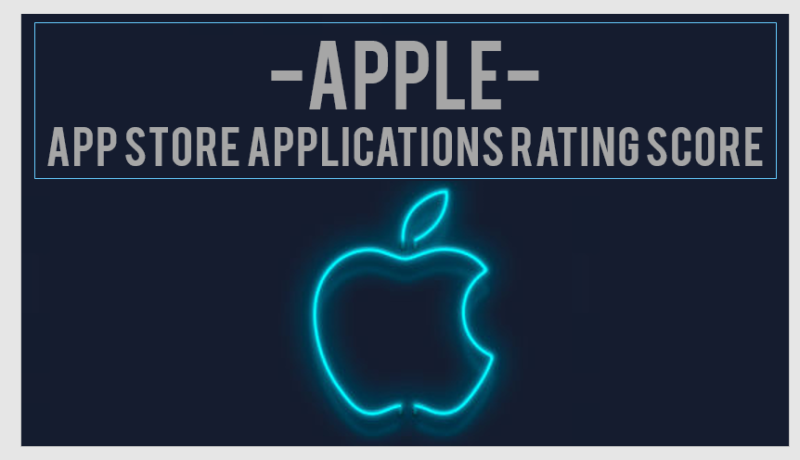
Maor Barel

Slide 2

Apple is a technology company founded in 1976. Apple has grown into one of the world's most valuable companies. Its key products include the iPhone, iPad, Mac computers, Air Pods and more, as well as services like the App Store, iCloud, Apple Music, and Apple TV+.
Apple who?

Slide 3






Data intro
Appstore applications
Data contains information about 7,561 apps available on the Apple AppStore, spanning from 2008 to 2019
ID
Unique identifier assigned to each app
User rating count
Shows the total number of ratings that the app has received from users
Name
Represents the name of the app
Average user rating
Represents the average rating that an app has received from users
Release date
represents the app's release date

Slide 4


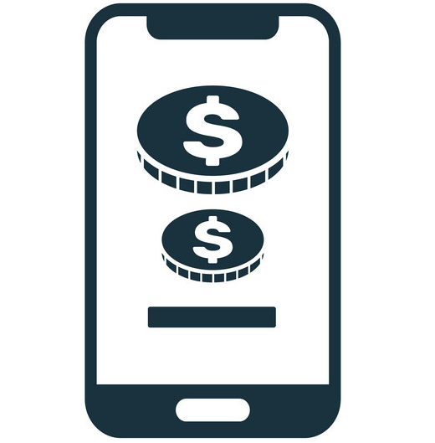

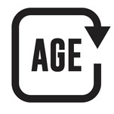

Data intro
language
Indicates the languages that the app supports
Price
Indicates the cost of the app
In app purchases
Indicates whether an app offers additional content or features for purchase within the app itself
Size
Represents the amount of storage space the app requires on a device
Age rating
Specifies the recommended minimum age for users of the app
Genre
Categorizes the app based on its type or content

Slide 5




Analysis Process & Research Target
Analyzing the Database from different aspects such as price, size, age rating, genre
Aiming to derive meaningful insights to help improve app development strategies
optimizing user satisfaction, and drive higher engagement and downloads
Understanding their impact on app ratings and user engagement

Slide 6
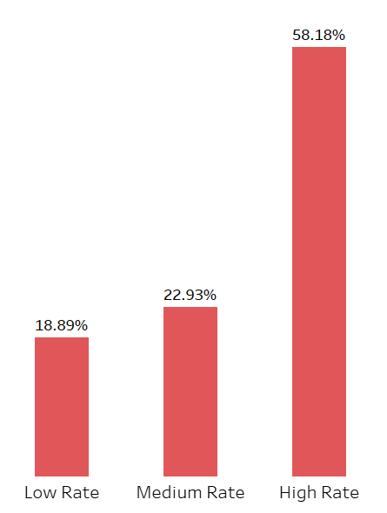
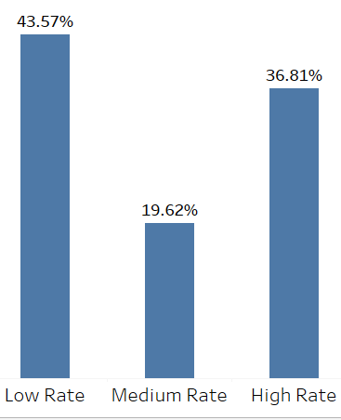
Apps Size & Ratings Category
Rating Category % For Small Sized Apps
Rating Category % For Big Sized Apps

Slide 7
Apps Size & Ratings Category
Conclusions
A majority of big-sized apps are highly rated (58.18%), indicating higher user satisfaction. Whilst only 36.81% small-sized apps rated highly.
A significant portion of small-sized apps are rated poorly (43.57%), while big-sized Apps (18.89%) have far fewer low ratings.
Overall Insight
Big-sized apps outperform small-sized apps in user ratings, with more high-rated apps and fewer low-rated apps. Meaning they are far more likely to deliver high quality experiences than small-sized apps.
Recommendations
Focus on improving quality and performance on small-sized apps to reduce low ratings.
Maintain high quality in big-sized apps and Improve medium rated apps to boost them to high ratings.

Slide 8
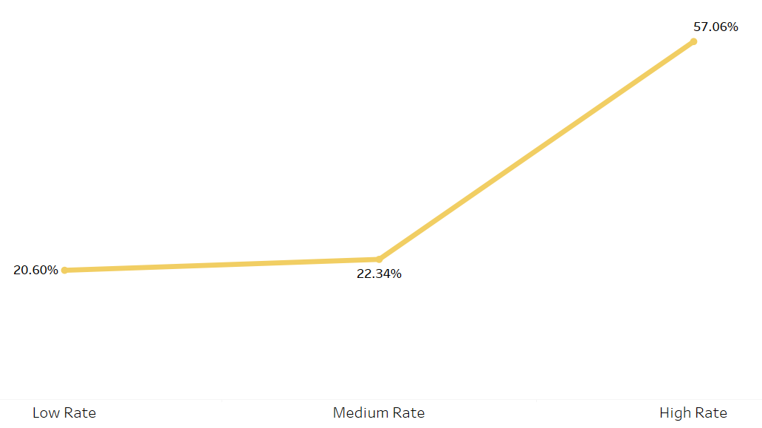
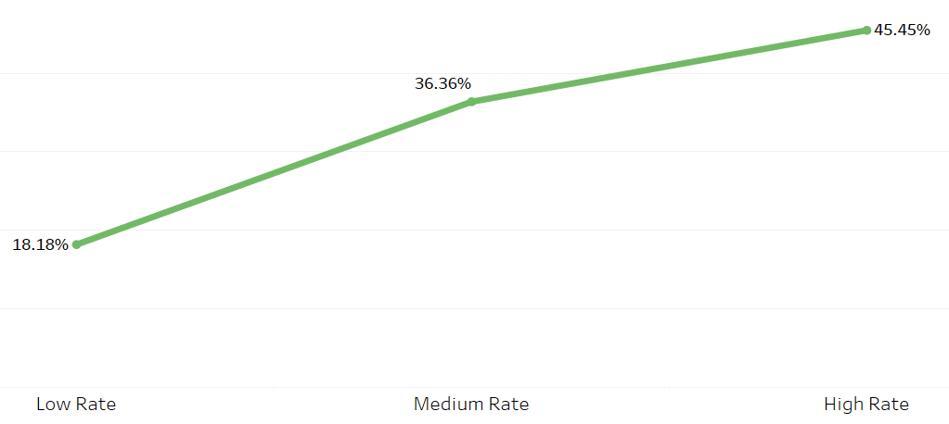
Free Apps With/out In App Purchase & Ratings
Rating Category % For Free Apps
With In App Purchase
Rating Category % For Free Apps
Without In App Purchase

Slide 9
Free Apps With/out In App Purchase & Ratings
Conclusions
57.06% of free apps with in-app purchases fall in the high rating category, indicating that users appreciate the value provided by these apps despite additional spending options. while 45.45% of free apps without in-app purchases are in the high rating category, which is lower than apps with in-app purchases.
Overall Insight
In-app purchases seem to have a positive impact on user satisfaction, as seen in the higher percentage of high ratings for apps offering this feature. However, even without in-app purchases, free apps still garner decent ratings, though less favorably.
Recommendations
Enhance In-App Purchase Experiences and Continue offering in-app purchases in free apps as they lead to higher user satisfaction. Focus on making in-app purchases valuable to further boost high ratings.

Slide 10
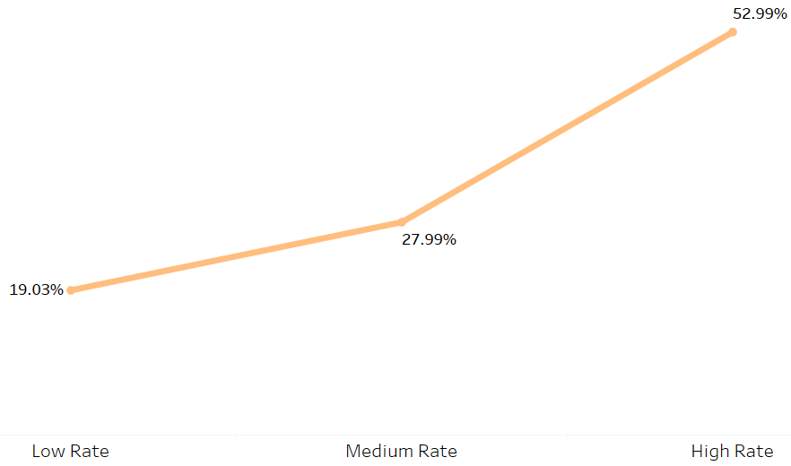
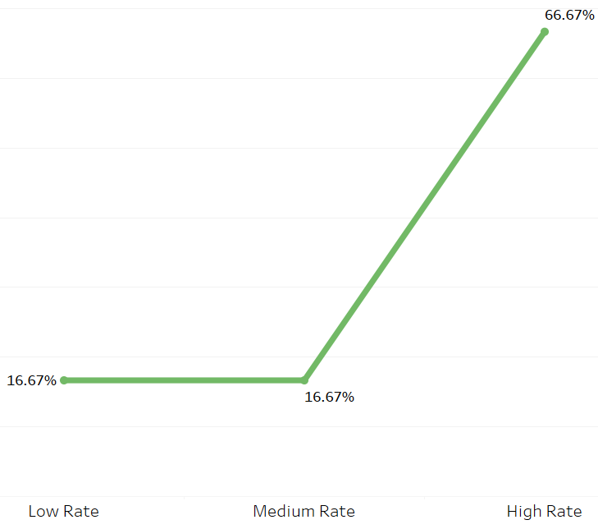
Paid Apps With/out In App Purchase & Ratings
Rating Category % For Paid Apps
With In App Purchase
Rating Category % For Paid Apps
Without In App Purchase

Slide 11
Paid Apps With/out In App Purchase & Ratings
Conclusions
Apps without in-app purchases have a higher percentage (66.67%) of apps with high ratings, compared to those with in-app purchases (52.99%).
For both of them, a smaller portion of apps falls into the low and medium rating categories. However, apps with in-app purchases have a relatively higher proportion of low and medium-rated apps compared to those without in-app purchases.
Overall Insight
Apps that are paid and do not include in-app purchases tend to have a larger percentage of high ratings compared to paid apps with in-app purchases. This could imply that users of paid apps prefer a one-time purchase model without additional in-app spending.
Recommendations
Developers of paid apps should
consider reducing or eliminating
in-app purchases to increase user satisfaction and potentially
achieve higher ratings.

Slide 12
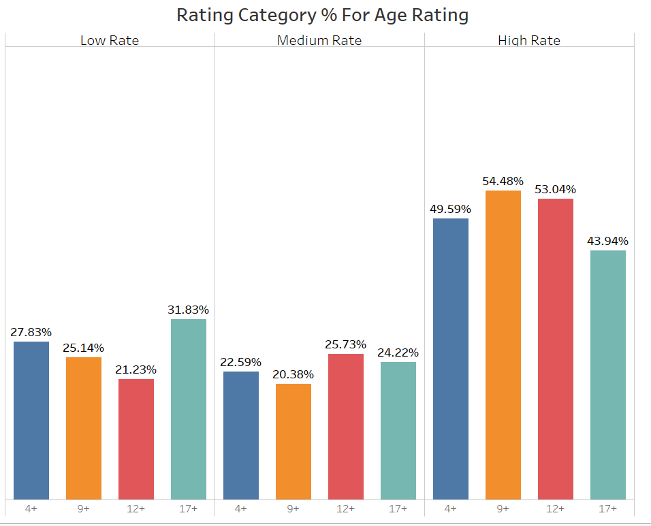
Apps Age Rating & Ratings Category
Rating Category % For Age Rating

Slide 13
Apps Age Rating & Ratings Category
Conclusions
9+ apps (54.48%) and 12+ apps (53.04%) have the highest ratings, while 17+ apps (43.94%) struggle with fewer high ratings.
Medium Ratings are balanced, with 12+ apps (25.73%) leading in average ratings.
17+ apps (31.83%) have the highest dissatisfaction, while 4+ apps (27.83%) also show significant low ratings.
Overall Insight
Apps targeted at younger audiences
(4+, 9+, 12+) tend to receive better ratings, while apps for older audiences (17+)
face more user dissatisfaction
Recommendations
for 17+ Apps Focus on improving the quality and experiences of apps for older users to boost overall satisfaction and to reduce low ratings.
Maintain Success audiences (4+, 9+, 12+) by continuing to provide simple and engaging content.

Slide 14
General Recommendation
Based on the data analysis and the insights gathered, my recommendation for the app development department is to give careful consideration to the app development process while taking into account the findings provided by the data analyst.
High-rated apps are often characterized by larger size, target a younger audience, and offer in-app purchase options. If the app is intended to be free, it is advisable to include in-app purchases, but if the app itself is paid, it is best to avoid additional costs within it. Taking these factors into consideration will increase the chances of success and achieve a high app rating.
Conclusion & recommendation

Slide 15
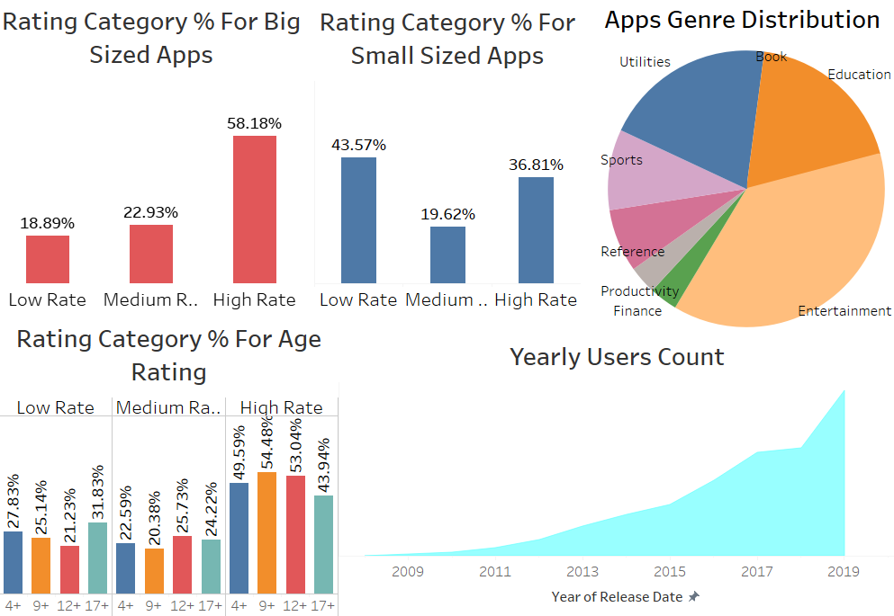
Appstore Applications Rating Score Dashboard
2008-2019

Slide 16
